Slide 1
Technoutsav
Theme :-
Data Science/Machine Learning
February 24, 2014
Prepared by: Team Predator

Slide 2
Table of Contents
page
page
page
page
page
3
4
5
6
7
Test Data
Test Image of Lane 1
Test Image of Lane 2
Test Image of Lane 3
Test Image of Lane 4
page
8
Result

Slide 3
Test Data
The Image are captured by the Camera at the traffic signal. The 4 images shows the 4 different sides of the traffic signals. The Images are then processed using our Python Code. The output of our program is shown on the same slide for convenience and etter understandability. Our Github Link is provided for in detail analysis of out code
.
Github Link :- https://github.com/maverick-ai/Machine_Learning_Traffic_Management

Slide 4
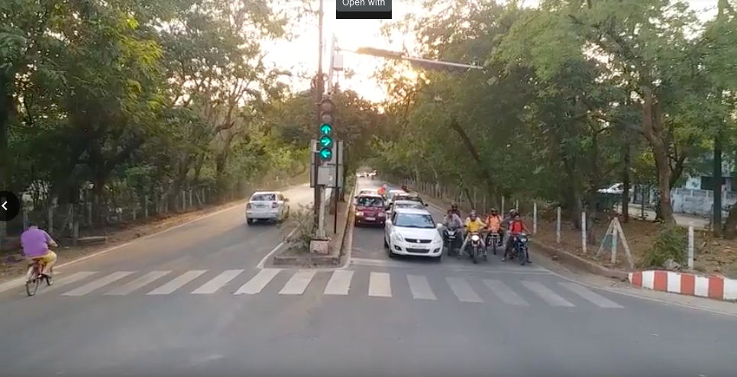
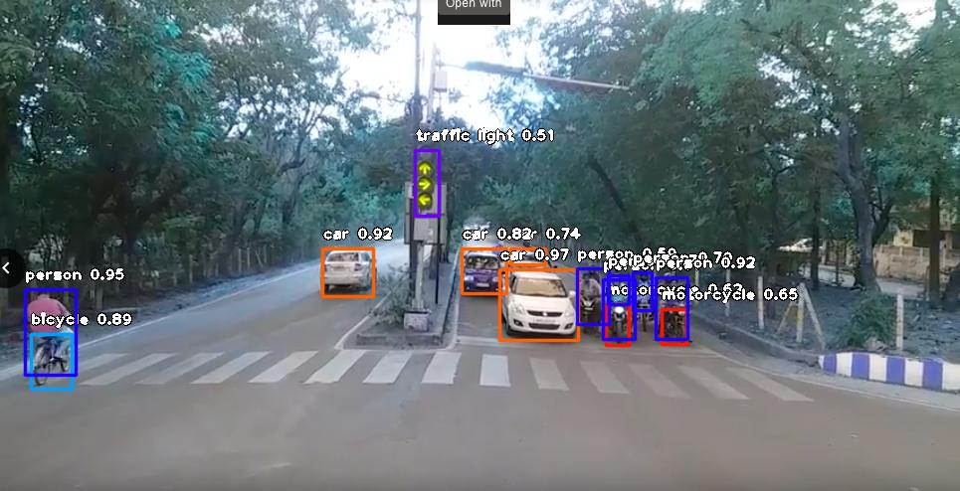

Capture and Processing image of Lane 1
.

Slide 5
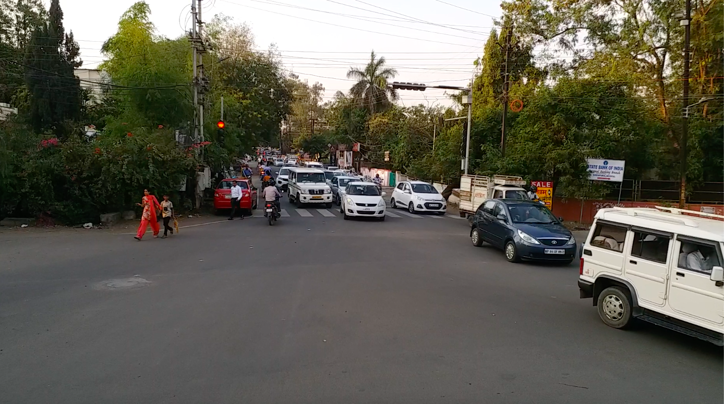
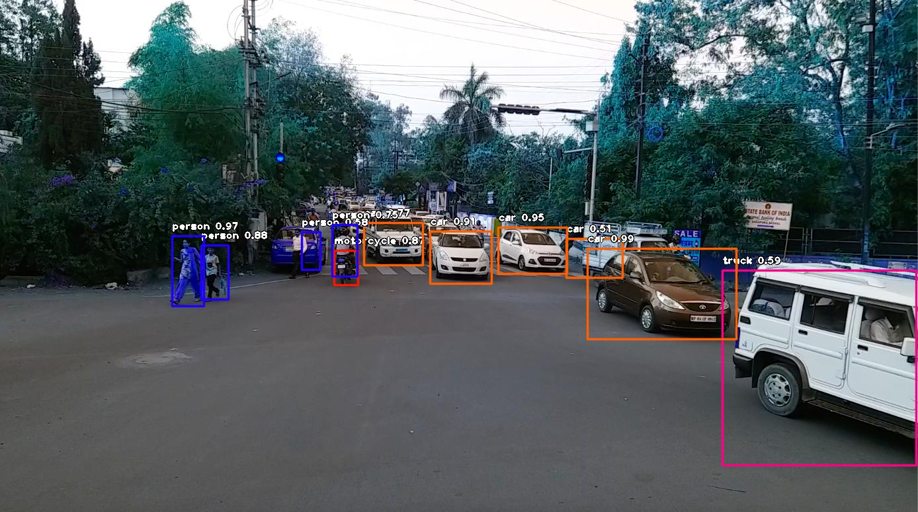
Capture and Processing image of Lane 2

Slide 6
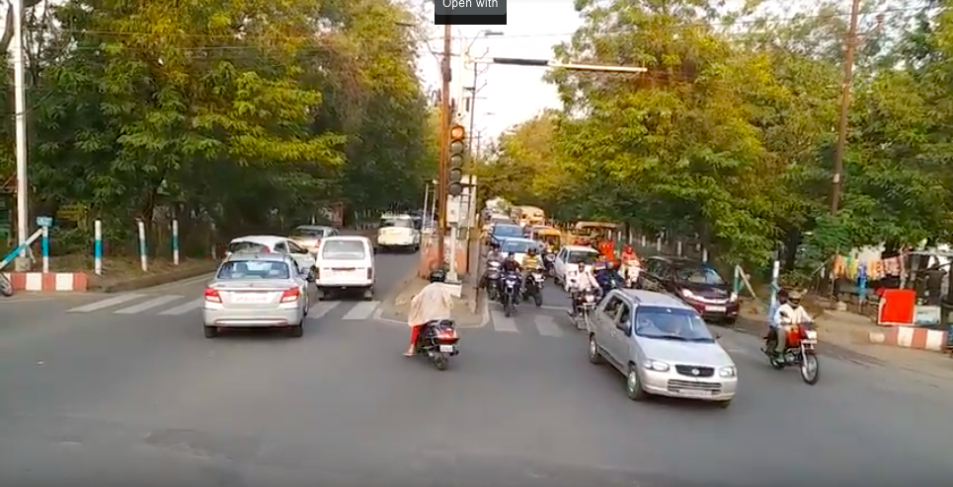
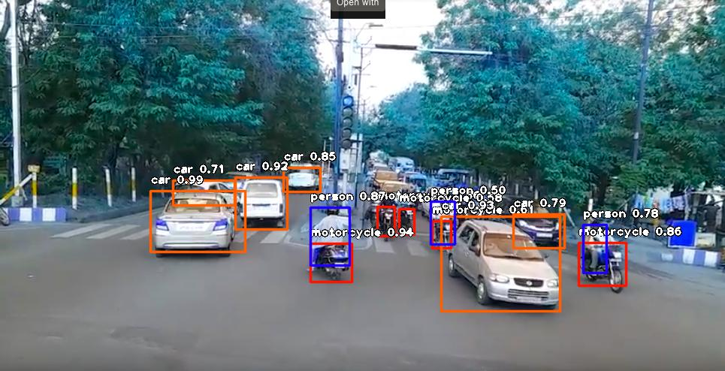
Capture and Processing image of Lane 3

Slide 7
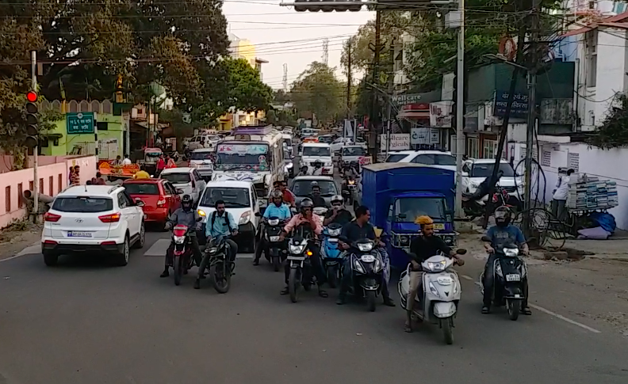
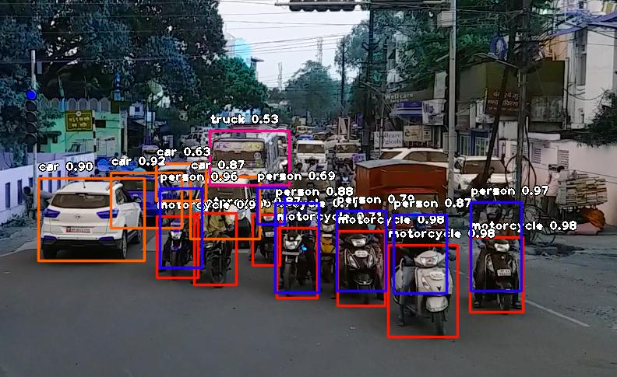
Capture and Processing image of Lane 4

Slide 8
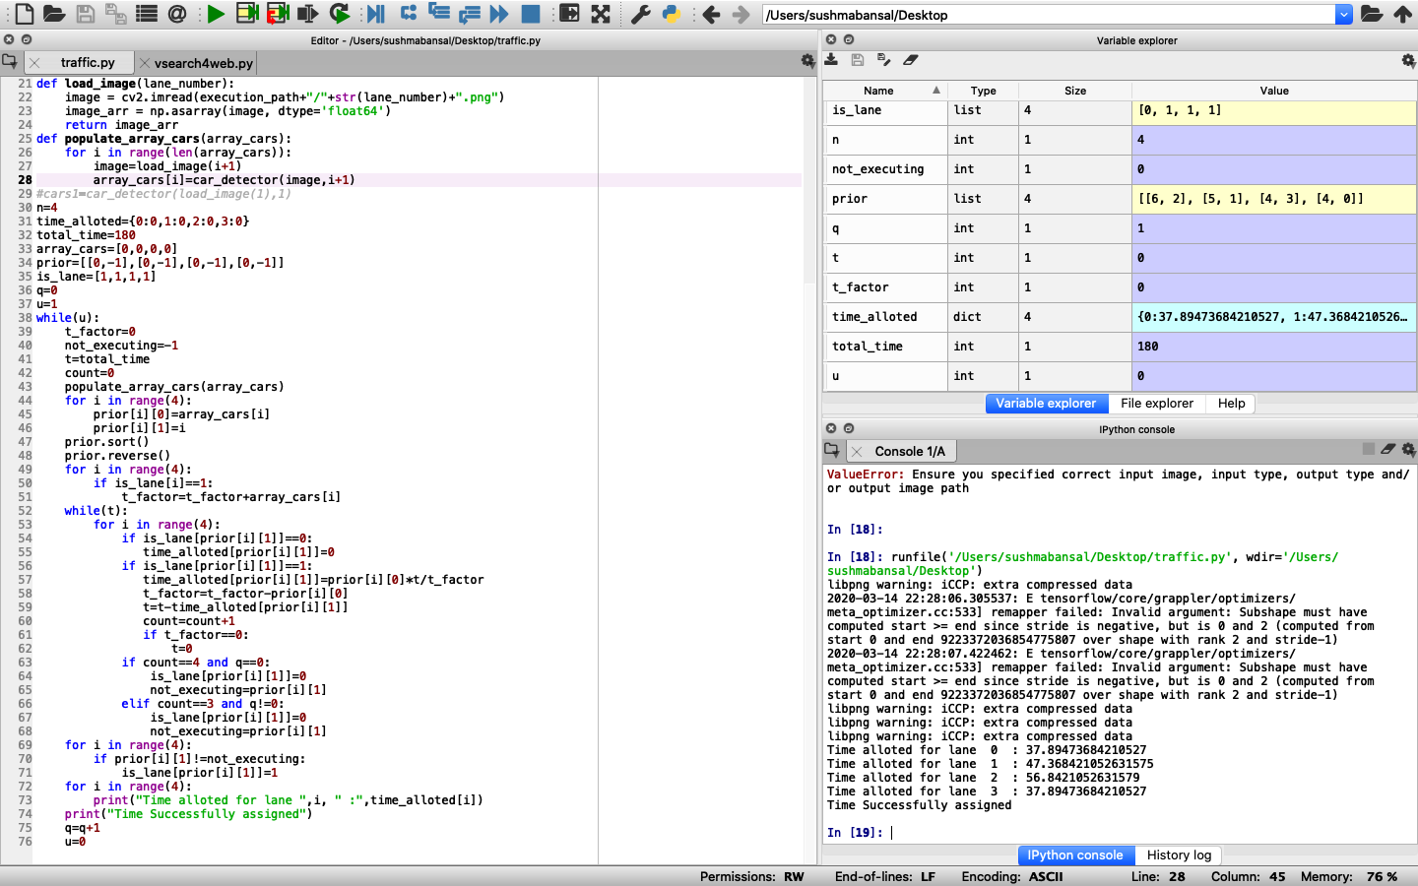
Screenshot with Result of Our Program
Time for lane 1 is 37 seconds
Time for lane 2 is 47 seconds
Time for lane 3 is 56 seconds
Time for lane 4 is 37 seconds

